Slide 1

Evaluate Techniques for Wifi Locationing
Sherri Koski
Oct 10, 2020

Slide 2
Objective
Investigate the feasibility of using “wifi fingerprinting” to determine a person’s location in an indoor space.

Slide 3
Wifi Data
The data was presented in two data sets. The first data set contains 19,937 points of wifi data, and the second set contains 1111 points of wifi data. Each data set contained the signal strength from 520 different wifi signals.
The data was collected by 18 different individuals in 3 buildings. Buildings 0 and 1 have 4 floors if the ground floor is included and building 2 has 5 floors including the ground floor.

Slide 4
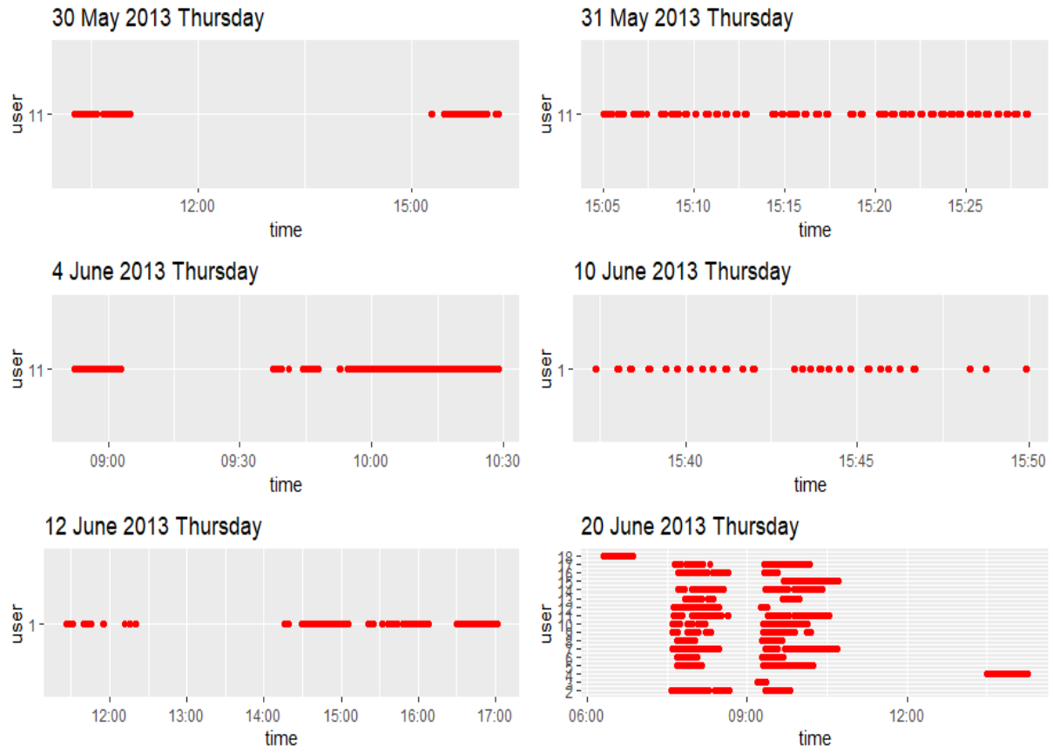
Data Collection
Data was collected by different users between 30 May 2013 and 20 June 2013. Most of the data was collected by several users on 20 June 2013.

Slide 5
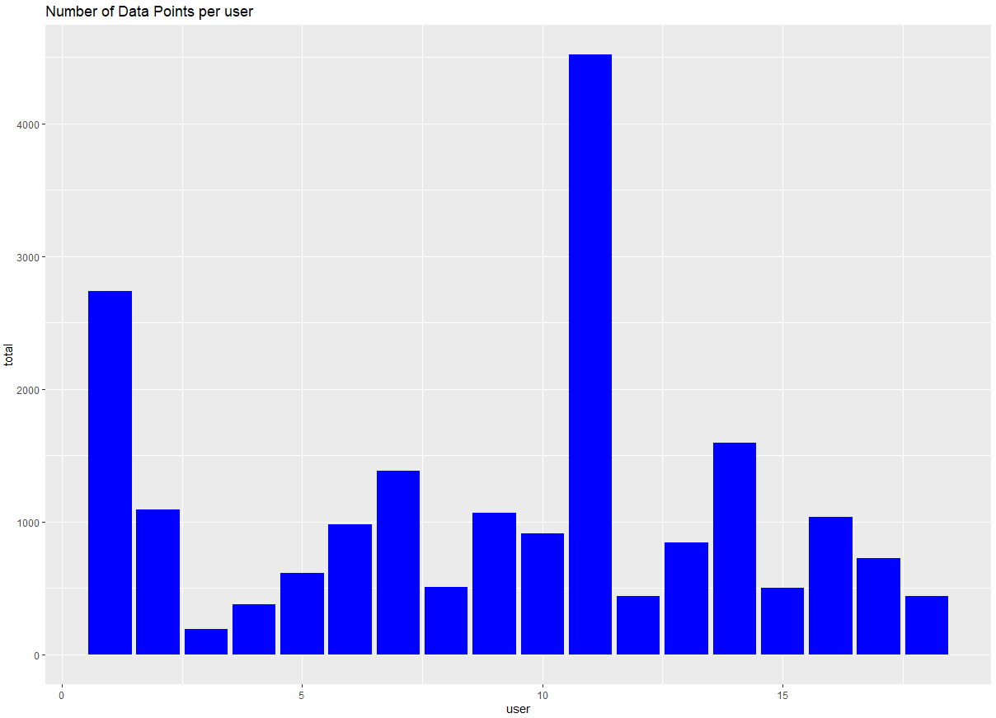
Count by user
Users 1 & 11 recorded by far the most data points.

Slide 6
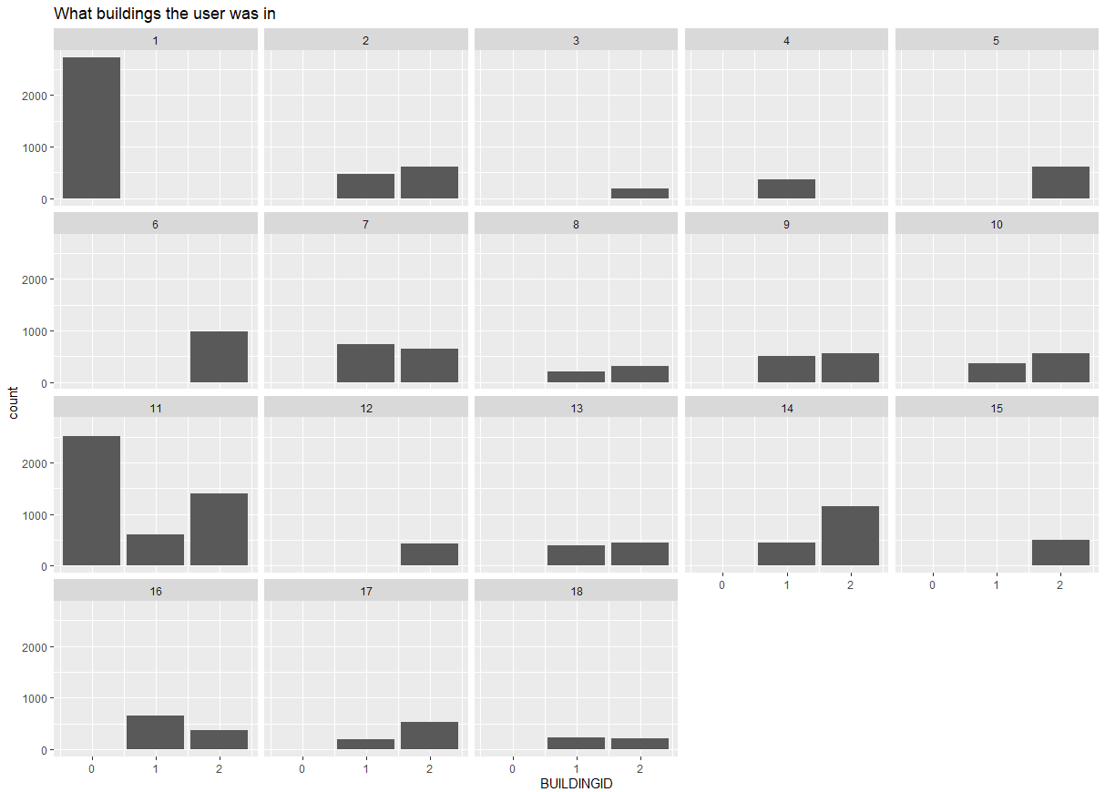
Where each user went.
Shows the number of data collection points users collected in each of the buildings they visited.

Slide 7
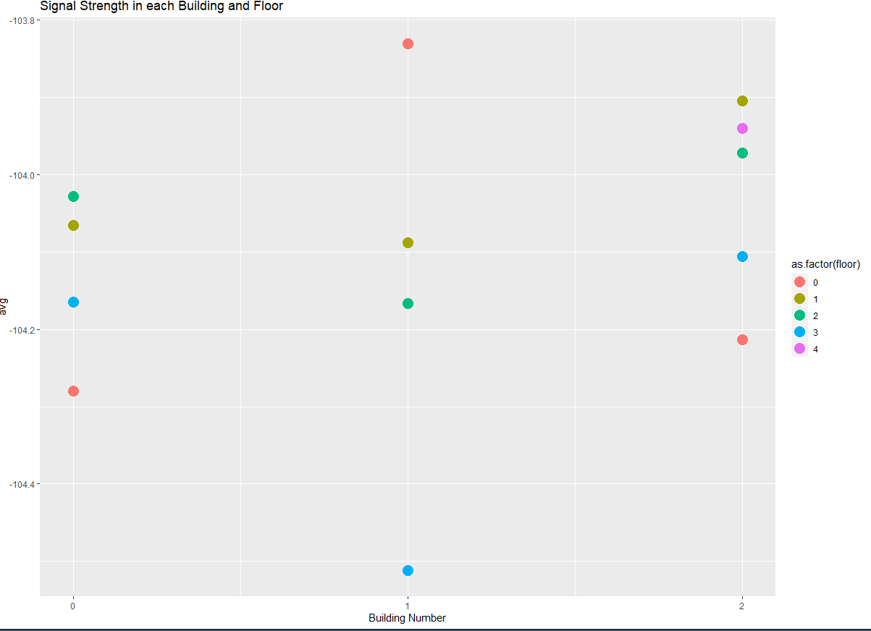
Wifi in each building
Wifi signal strength collected also depended on the building and floor.

Slide 8
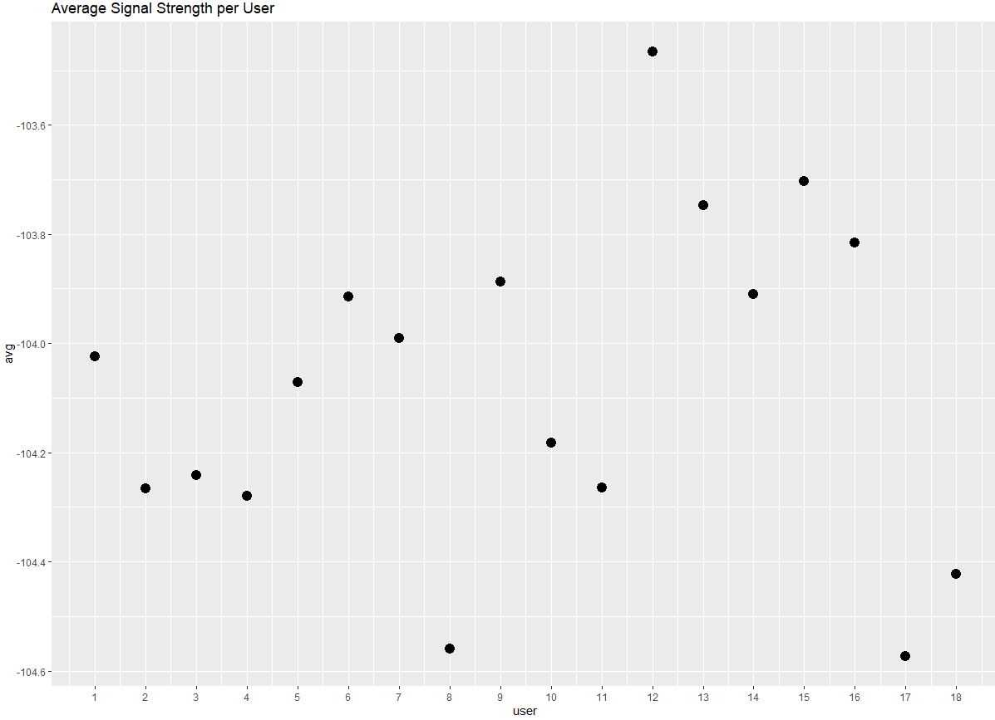
Signal Strength
Not all signal strength was equal. User number 12 had good signal strength while users 8 and 17 had weak strength.

Slide 9
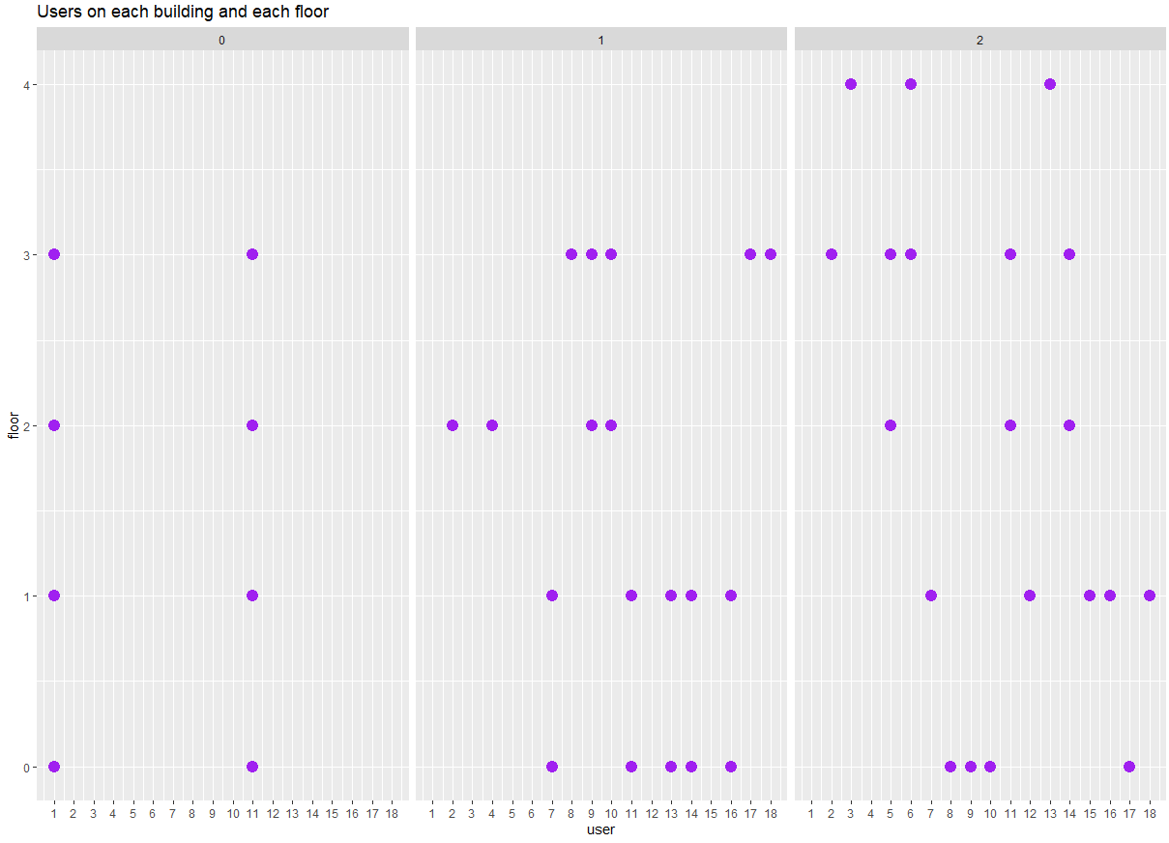
By building and floor.
Some users visited multiple buildings, and some visited multiple floors.
User 1 and 11 were the only data points from building 0.

Slide 10
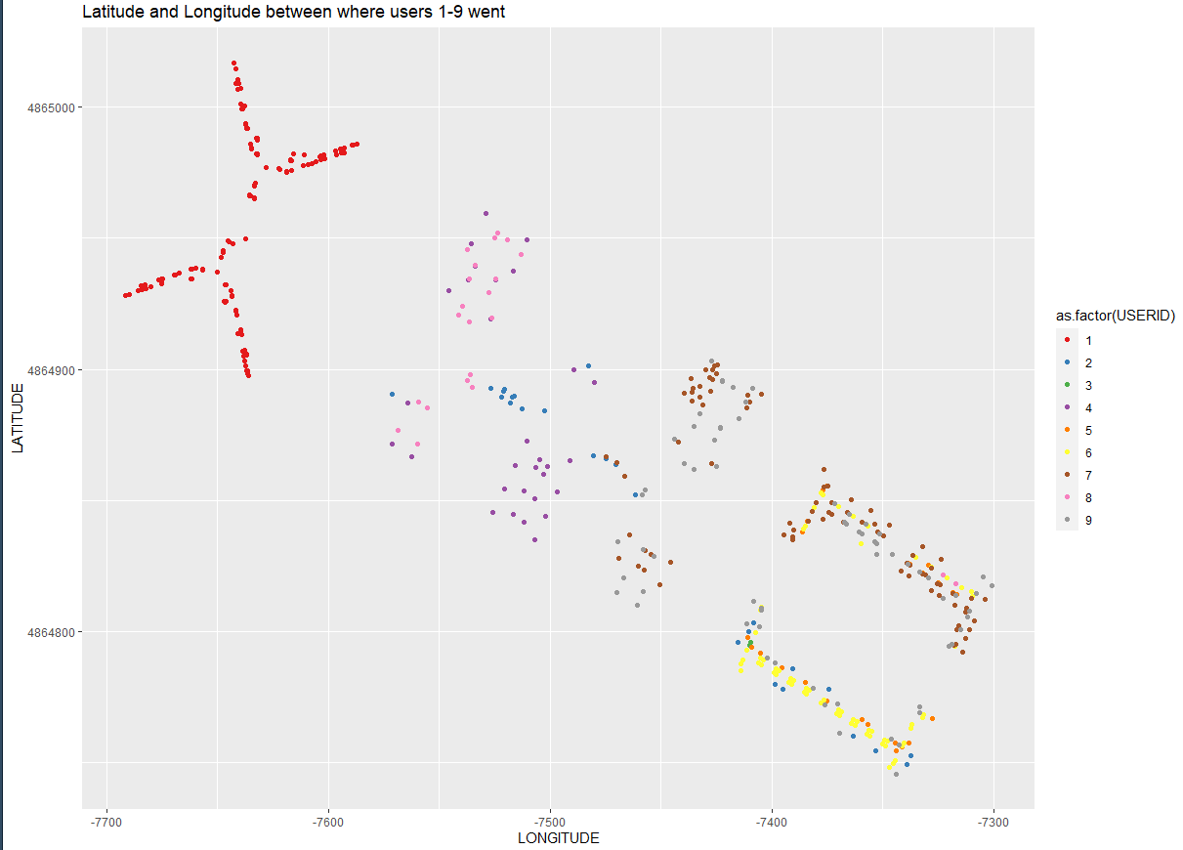
Data path
Interesting graphic shows not only the shape of the building but also the path of the users 1-9.

Slide 11
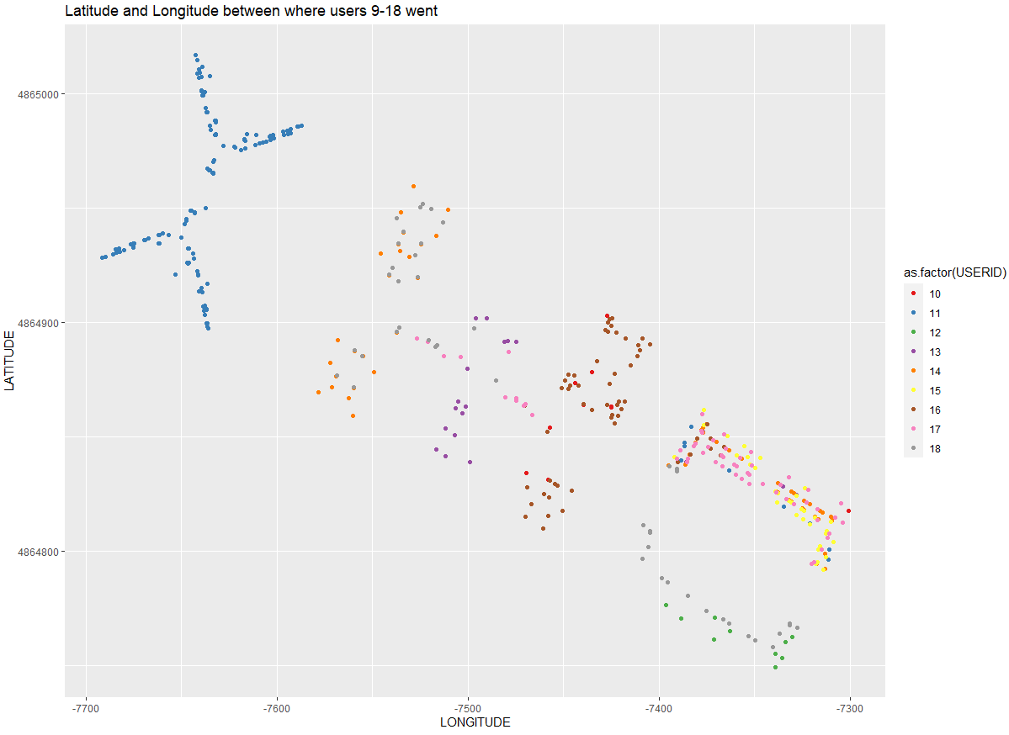
Data path
Interesting graphic shows not only the shape of the building but also the path of the users 10-18..

Slide 12
Data Organization
Data was prepared into 3 separate groups.
Wifi location by building
Wifi location by building and floor
Wifi location by building, floor and space id.
I did not use the user id, phone id, relative space id, or longitude and latitude when I built my models.
I relied solely on the 520 data points from wifi strength to predict building, building and floor, or building, floor and space id.

Slide 13
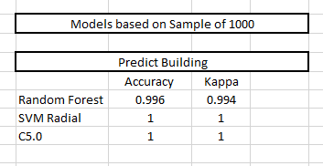
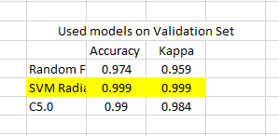
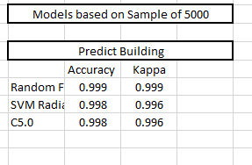
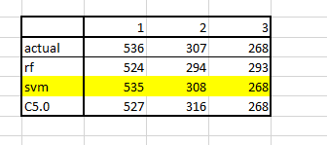
Predict the Building
Models Used: Random Forest, SVM Radial, a C5.0 (all Caret)
All models preformed very well in predicting the building.
Using the validation set of 1111 data points. Svm out- performed just by a hair.
Models predicted over 99% accuracy with test samples of 1000 and 5000

Slide 14
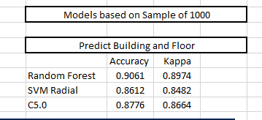
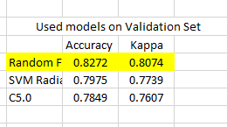
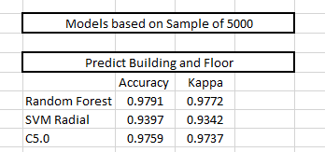
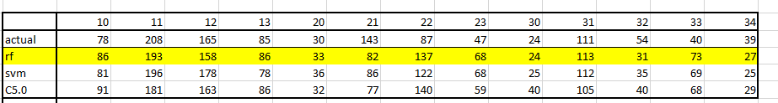
Predict the Building and Floor
Models Used: Random Forest, SVM Radial, a C5.0 (all Caret)
Random Forest was best with both tests sets of 1000 and 5000 samples
However, when ran with the validation set, random forest preformed at 0.8272

Slide 15

Predict the Building, Floor, and Space
Models Used: Random Forest
Due to the lengthy run time, a decision was made to use Random Forest.
Note: I was surprised that space id was not unique to individual buildings. Several building contained space 103. I added the building number in front of the space id to create a truly unique space id.
Random Forest ran at 63% accuracy

Slide 16
Thoughts for further investigation
To get better results using the unique building space id, I would like to combine different spaces to create little larger space ids. If rooms are close to each other then it would not make a difference which space the wifi thought I was in. I can imagine that rooms across the hall or adjacent to each other gather similar wifi signals.
Machine Learning doesn’t consider it accurate if the algorithm predicts that you are in room 102 when you are really 6 feet away in room 101.
This would be my next step.

